Slide 1
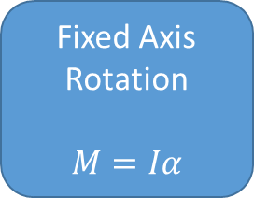
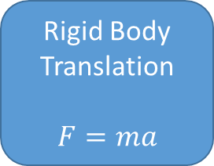
Newton’s Second Law
(Rotational)
Newton’s Second Law
(Translational)
Rigid Body Kinematics
Fixed Axis Rotation
$$M=Iα$$
Rigid Body Translation
$$F=ma$$
General Planar Motion
Newton’s Third Law
Multi-Body
General Planar Motion

